Slide 1
Annotator’s Training

Slide 2
Five Steps of Annotation
Annotating the messages:
Peer Support category of the messages
Language (word-level) of the messages
Sentiment of the messages
Typo/Abbreviations
Topic Change

Slide 3
Sentiment Annotation
Definition : Sentiment is a view or opinion that is held or expressed by an individual. In this setup, we need to understand the sentiment of each message in the chat to get a deeper sense of understanding the patterns by which the peer supporters interact with each other in the HIV positive groups in Africa.
A . Negative Sentiment :
It expresses some sort of negative feeling or view or opinion about someone or something.
a. “You have a mental problem it's no secret.”
This expresses some sort of anger/rudeness against someone, which clearly expresses a negative view or opinion.
b. “You should try going offline”
This also expresses some sort of anger/rudeness against someone, asking him/her to not disturb anymore, which clearly expresses a negative view or opinion.

Slide 4
Sentiment Annotation
B. Positive:
It expresses some sort of positive feeling or view or opinion about someone or something or not even a view (aka a neutral statement).
Example:
“VaXXX said that then went missing...But she said it's her friends experience..”
This expresses a neutral comment.
b. “When are you coming?”
This also expresses some neutral comment/question.
c.” We are good”
This also expresses some neutral comment

Slide 5
Annotation of the Categories: We require the annotation of the conversation chats to be carried out in two steps. Initially, we would like to categorize the different utterances into six main categories, then further subcategorize them, which is further described in Table 1. Step 1: This is the initial step of identifying the broader categories of utterances or messages. The broader categories include: a. Informational b. Emotional c. Group Work d. General chit-chat e. Acknowledgement f. Others

Slide 6
Information Category
Definition :
In this category, the group members discuss and provide certain factual information, advice or warning.
There are two types of attributes for this category:
Seek : In this category, the user asks for any information or advice from their fellow group members.
Values: Yes / No
Provide : In this category, the user provides any information or advice to their fellow group members.
Values: Yes / No

Slide 7
Some Examples:
Examples:
“For any infection, a certain minimum amount of virus or bacteria is required for the infection to be transmitted. By taking ART regularly, the amount of the virus remains below that infective dose. Because of this, the virus is not transmitted. This is true for mother to child transmission, as well as sexual transmission of HIV.” (Attribute : Seek: No, Provide: Yes)
“TB is A potentially serious infectious bacterial disease that mainly affects the lungs.” (Attribute : Seek: No, Provide: Yes)
“Most people infected with the bacteria that cause tuberculosis don't have symptoms. When symptoms do occur, they usually include a cough (sometimes blood-tinged), weight loss, night sweats and fever.” (Attribute : Seek: No, Provide: Yes)

Slide 8
“HIV weakens the immune system, increasing the risk of TB in people with HIV. Infection with both HIV and TB is called HIV/TB coinfection” (Attribute : Seek: No, Provide: Yes)
“Hi....This is a big warning...my mother in law has just lost over Kes. 70,000 to M-Shwari and KCB-MPESA con-women...Please take note that there criminals who are going round pretending to give out free Airtel and Orange lines....in the process of registering your new free line they take all your details I.e. ID No, Date of Birth etc... After that they immediately send you some little money in your mpesa line. Thereafter they immediately contact Safaricom pretending that they have forgotten their mpesa password...Some of the questions asked by Safaricom include: your ID no, your date of birth and your last transaction-easily quoting what they have just send you...with these details Safaricom gives them a new mpesa password...and with urgency and within minutes, the crooks use your line to get maximum allowable loans from all mobile phone based creditors…” (Attribute : Seek: No, Provide: Yes)
“Explain further about circumcision” (Attribute : Seek: Yes, Provide: No)

Slide 9
2. Emotional:
Definition :
In this particular category, the group members seek emotional support or communicate empathy, love or concern towards their fellow members.
Examples:
“I know it's hard to take in the pain of losing your child 😭...but then, brave on💪🏽....This...This is not the only child you would have had 😊”
“Please never give up on yourself, I know you will survive”.

Slide 10
3. Group Work
Definition :
A response that suggests that the users encourage others to remain responsive and promote universalization/togetherness for support.
Examples:
“Let's bring topics even on the contemporary experiences so that we can continue keeping the group more active as it should be guys!”
“Together we shall overcome any fear”.
“It's the weekend. Let's start stories ”.
“Guys are silent I guess they have no issues now, but we should still keep in touch”
"Hi kwani hambongi bana"

Slide 11
4. General Chit-Chat :
Definition :
In this category, the group members introduce or greet each other and promote social interactions to demonstrate friendliness.
Examples:
“Hello, good morning”
“Happy easter guys”
“Who is calling me for easter”
“Hello, cool sunday pips”
“How was your meal guys?”
“Are you a boy or a girl”
"poa. Umeshinda aje GaXXX?"

Slide 12
5. Acknowledgement :
Definition :
A response that is meant to acknowledge other's proposal or politely expressing gratitude towards someone's actions.
Examples:
“Thanks I'll attend the meeting”.
“Yes, I think so”
“Exactly, same here.”
“Hey, appreciate for your efforts”.
"Sawa kabisa."
6. Others :
Definition :
A response which does not signify any important message, might contain an emoji or any system generated message.
Examples:
“Waiting for this message”
😂😂😂

Slide 13
Categories | Subcategories (Acronyms) | Attributes
Informational | 1. Medical information/advice 2. Personal Life information/advice 3. Healthy Lifestyle Information/advice 4. Admin Related Information/advice 5. Other Information/advice | Seek/Provide
Emotional | 1. Empathy 2. Encouraging to be Hopeful 3. Expressing negative feelings 4. Expressing happiness
Group Work
General Chit-chat | Social Interactions 2. Greetings
Acknowledgement
Others
Fine-grained Sub-Categories:
Table 1: Categories of the Chat

Slide 14
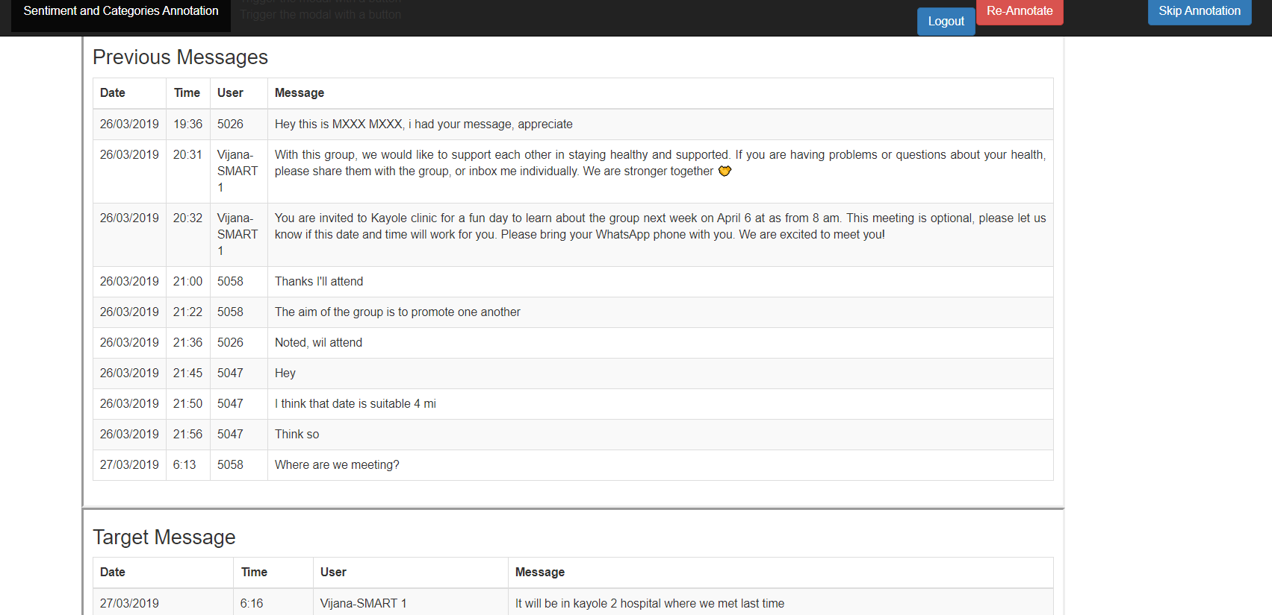
If you are comfortable annotating the messages, proceed or else press the skip button

Slide 15
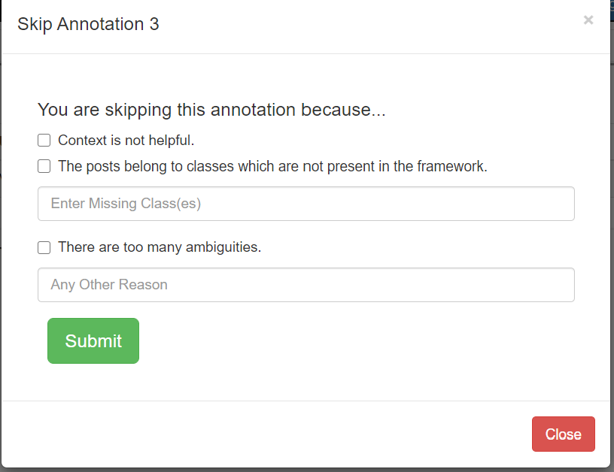
If you are choosing to skip the annotation, you can specify the reason of skipping and then press submit !

Slide 16
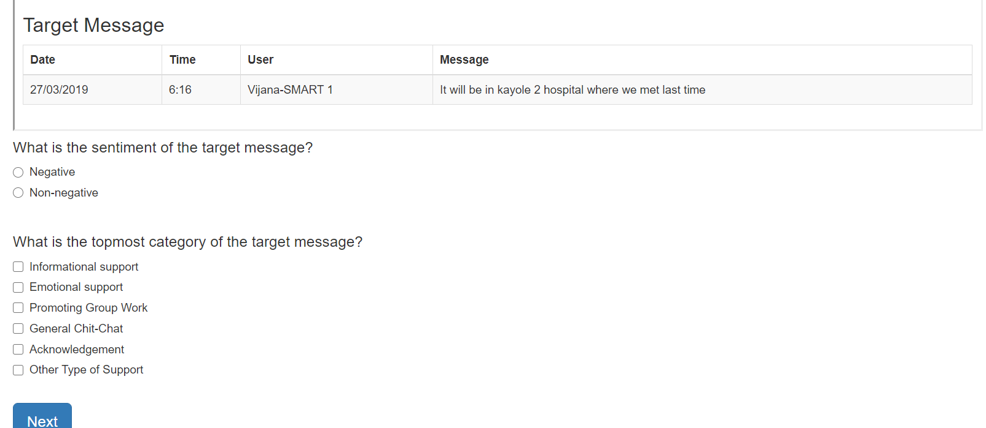
Or else, if you wish to continue then choose the broader category/categories and also the sentiment in the tool and then press Next Button to proceed

Slide 17
Sub-Categories of Informational

Slide 18
Medical information/advice:
Definition :
This type of category deals with providing/seeking any factual information, advice or warning about some medicine, treatment or disease.
Examples:
“Most people infected with the bacteria that cause tuberculosis don't have symptoms. When symptoms do occur, they usually include a cough (sometimes blood-tinged), weight loss, night sweats and fever.” (Type: Provide)
“TB is A potentially serious infectious bacterial disease that mainly affects the lungs.” (Type: Provide)
“Transmission of HIV is dependent on many factors including the viral load of the HIV positive partner, the amount of body fluid exchanged between the partners, and any injuries, sores or ulcers on the genital regions of either partner. Transmission rates for HIV are estimated to be between 0.03% to 0.3% for heterosexual vaginal intercourse.” (Type: Provide)

Slide 19
2. Personal Life information/advice:
Definition :
This type of category deals with providing/seeking any factual information, advice or warning about their relationship with partner or other members of the family.
Examples:
“You should consult your doctor or HIV counsellor and have a detailed discussion with them regarding the same. You should also make it a point to use condoms during future sexual intercourse.”. (Type: Provide)
“As we get older and have sexual relationships, it's important to protect ourselves and our partners from STIs and unwanted pregnancy. Barrier methods like condoms prevent STIs and pregnancy. There are many other methods to prevent pregnancy (they don't prevent STIs) https://www.avert.org/sites/default/files/Options%20for%20contraception%20-%20Worksheet.pdf. Also, for HIV, if we are not undetectable, our negative partner can take PrEP to protect themselves. https://twitter.com/nimejiprep?lang=en. ’’ (Type: Provide)

Slide 20
3. Healthy Lifestyle Information/advice :
Definition :
This type of category deals with providing/seeking any factual information, advice, warning about their daily lifestyle habits.
Examples:
“2 eggs Ksh. 20, a banana Ksh. 5, tomato Ksh. 5. Does anyone have other tips on getting enough food before taking medications? .” (Type: Seek)
“You can take a lot of soup,turtle beans and fish. These work well for new moms. Don't drink coffee or tea. Use only cocoa. (Type: Provide)
“I need your help , am trying to stop eating stones but I can't, at first I knew it's because of the pregnancy. But after delivery my child is almost one year and I still have stone cravings!!!” (Type: Seek)
“Alcohol may lower your level of immunity making other diseases like vomiting, diarrhea etc to attack you.” (Type: Provide)
“Smoking, either passively or actively is dangerous especially to us here. It raises your risk of heart disease, cancer, serious lung diseases i.e. pneumonia etc. So it's not good at all.” (Type: Provide)

Slide 21
4. Admin-Related Information:
Definition :
This type of message deals with providing/ seeking any factual information, advice, warning about formal meetings with the admin or purpose of the group.
Examples:
a. Group is private, we shall not share our messages with anyone else not in the group
b. We shall respect all members and not use words like HIV, ART,CD4, VL. So that people feel comfortable.
c. Make sure you have security code or applock in your phone
d. We Will be sharing challenges and good stories here
e. We will Be thoughtful of our messages and responses to one another or pics we send
f. I will be sending our Weekly messages every Sunday at 10pm, but nyinyi ninaendelea to na conversation zenyu
g. The group proposed they will be calling me Admin. 👍🏽
(Type: Provide)

Slide 22
5. Other Information:
Definition :
This type of category deals with providing/seeking any factual information, advice, warning about topics excluding medical, personal life, healthy lifestyle or admin related information.
Examples:
“Hi....This is a big warning...my mother in law has just lost over Kes. 70,000 to M-Shwari and KCB-MPESA con-women...Please take note that there criminals who are going round pretending to give out free Airtel and Orange lines....in the process of registering your new free line they take all your details I.e. ID No, Date of Birth etc...After that they immediately send you some little money in your mpesa line. Thereafter they immediately contact Safaricom pretending that they have forgotten their mpesa password...Some of the questions asked by Safaricom include: your ID no, your date of birth and your last transaction-easily quoting what they have just send you...with these details Safaricom gives them a new mpesa password...and with urgency and within minutes, the crooks use your line to get maximum allowable loans from all mobile phone based creditors…” (Type: Provide)

Slide 23
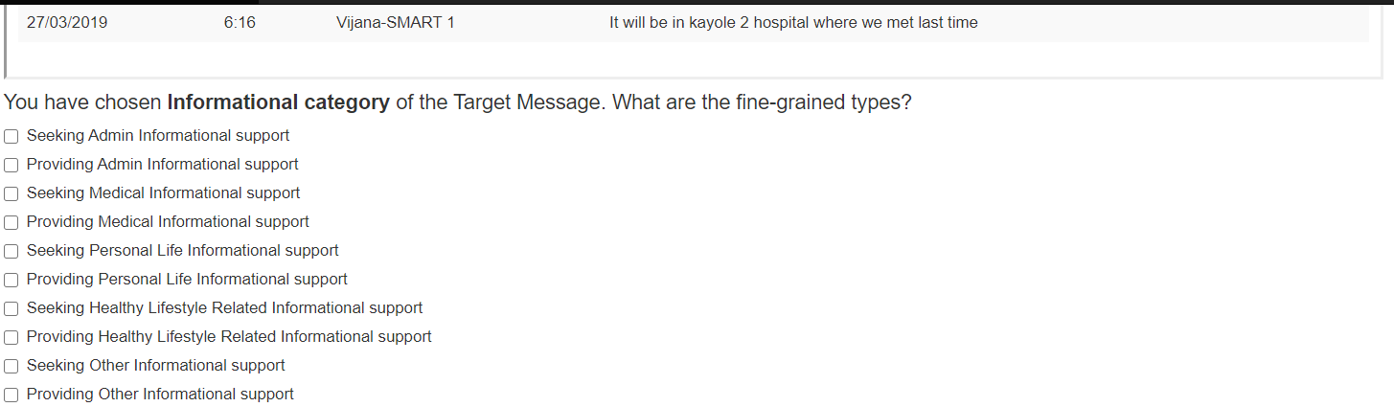
Choose an informational Category and also whether it’s a seek/provide type of information

Slide 24
B. Emotional:
Empathy:
Definition :
A response that explicitly includes a mention of the difficulty experienced by the seeker in a way that is validating his/her distress or indicates an attempt to see things from the seeker’s perspective.
Examples:
“I can relate to you at so many levels”
“Yeah. but i understand we are dealing with the same issues in this regard”
“Same here also and another problem is that he got me pregnant”

Slide 25
2. Encouraging to be Hopeful:
Definition :
This category is defined when the responder encourages continued efforts/persistence and inculcates hope.
Examples:
“Sorry for this dear. Like 5002 has said some things need sacrifice and time. Never give up .Just try and overcome the hurdle, all will be fine .”
“Please try, I know you will survive”
3. Expressing happiness:
Definition :
In this category, the group member is narrating some good incident in a happy mode or showing some excitement towards anything.
Examples:
“Early this month, we were blessed with a baby girl and we thank God for His mercies on us. This makes us more strong and urges us to work more on how we shall live tomorrow”
“She is turning 4 months by 1st Aug and we are so happy”

Slide 26
4. Expressing negative feelings:
Definition :
In this category, the group member is narrating some bad incident in a mournful mood or expressing anger/sorrow/frustration or any negative emotion towards anything.
Examples:
“ The water was ice cold , I felt it on my spinal cord until to the liver and twelve other organs failed.😥😤. I was scared that I found myself sitting on the toilet washing my foot and wiped the soap off my body with a towel . I cant die of cold then my body to be found naked”
“Hello guys am feeling so bad today i have a headache and i also don’t have energy please pray for me”

Slide 27
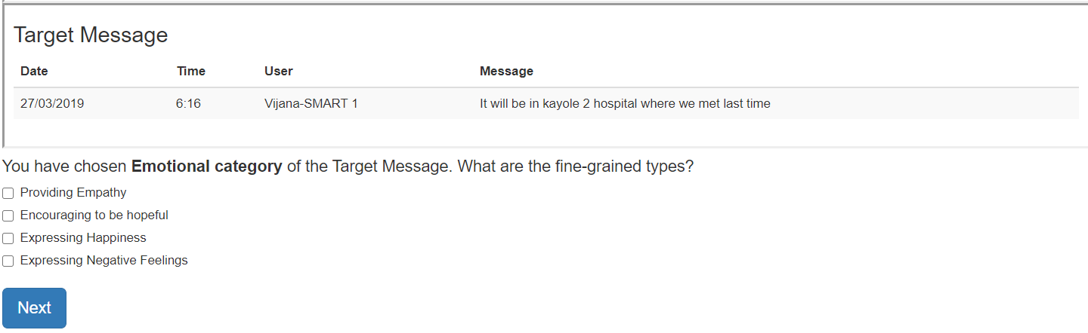
You can choose one or more categories from the broader emotional category !!

Slide 28
General chit-chat :
Definition :
In this category, the group members introduce or greet each other and talk about personal interactions to promote friendliness.
The following types of codes will fall into this category:
Social Interactions:
Definition:
In this category, the group members try to know their peers more by chatting express willingness to personally introduce themselves or arrange for personal meetings.
Examples:

Slide 29
Examples:
“Hey guys.. I have missed you a lot!!”
“Where do you stay?”
“I stay in Njiru”
“M from home with honey. How many are in for it??😊😊”
“Hey, welcome for lunch today”
“Come, supper is ready😊
2. Greetings:
Definition :
It is an act of communication in which human beings intentionally make their presence known to each other, to show attention to, and to suggest a type of relationship or social status between individuals or groups of people coming in contact with each other.
Examples:
Good morning all
Good night
Happy Easter

Slide 30
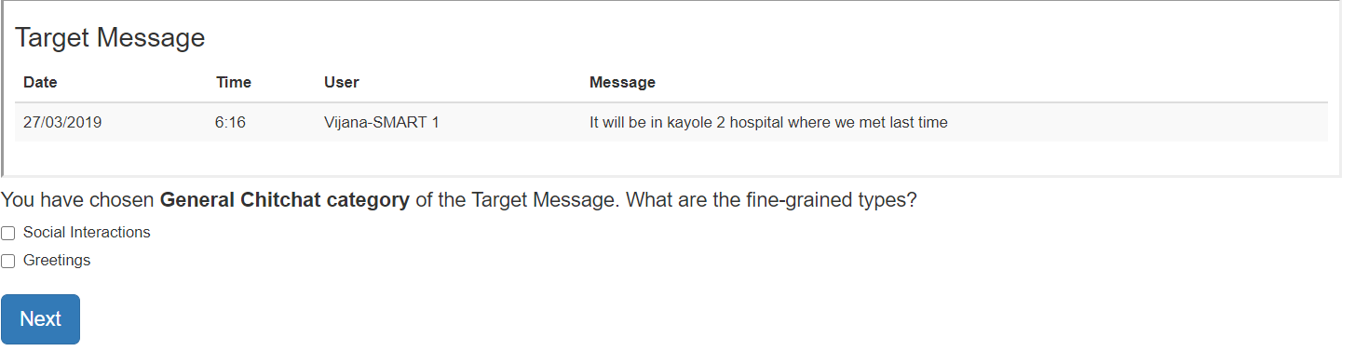
You can choose one or more categories from the broader General Chit-Chat category !!

Slide 31
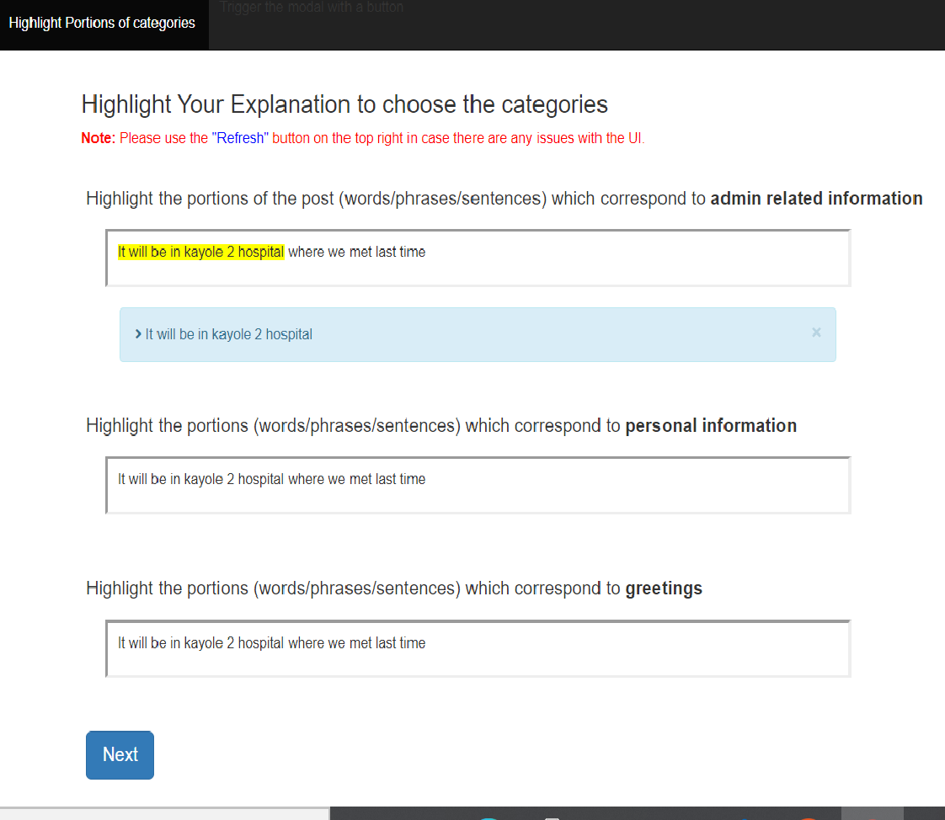
You should highlight a word/span in the message which helps you to determine the category and subcategories

Slide 32
Language ID Annotation Framework: To understand the interactions from the perspective of code-mixing, we need to annotate the language used by the group members on a word-level basis. For each one of the messages, we would like to annotate the language of each word (word-level) language id annotation. For example:
Original Message: Mimi nilichukua my siz tukalost
Language (SW) (SW) (En) (En) (CM)
Translation: I took my sister and we got lost
We are considering five types of language identification codes:
1) En: Stands for English
2) Sw : Stands for Swahili
3) Sh: Stands for Sheng
4) Oth: For other languages.
5) Code-mixed : For code-mixed languages

Slide 33
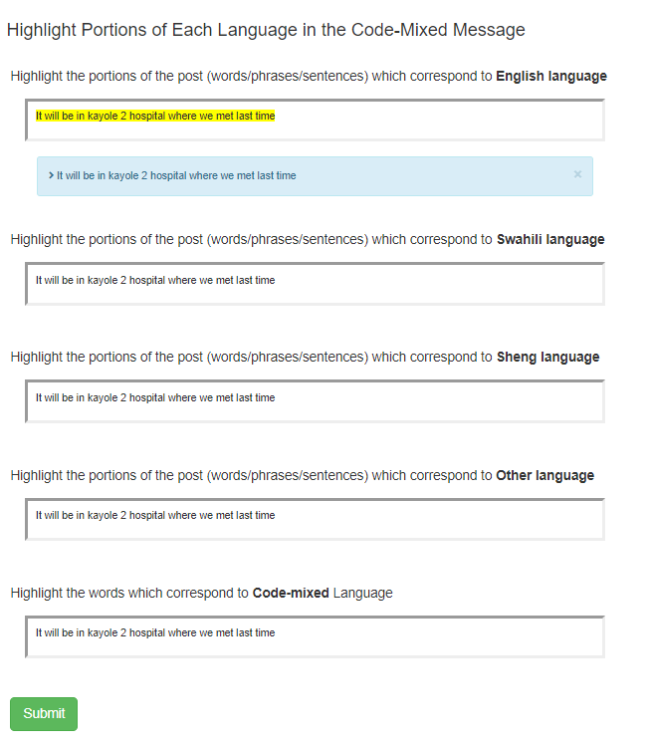
You should highlight all the words/spans in the message which correspond to these language categories !!

Slide 34
Thank You !!

